Slide 1
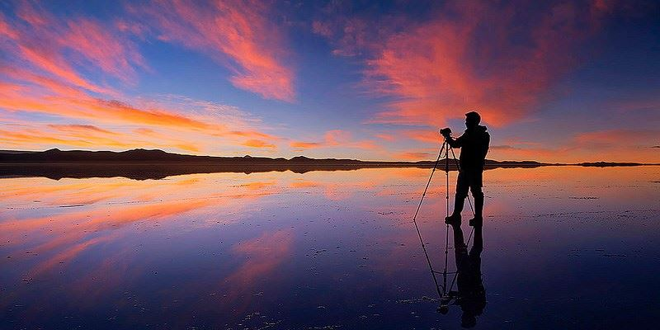
Uyuni Salt Flats
By Aaliyah Ibrahim

Slide 2
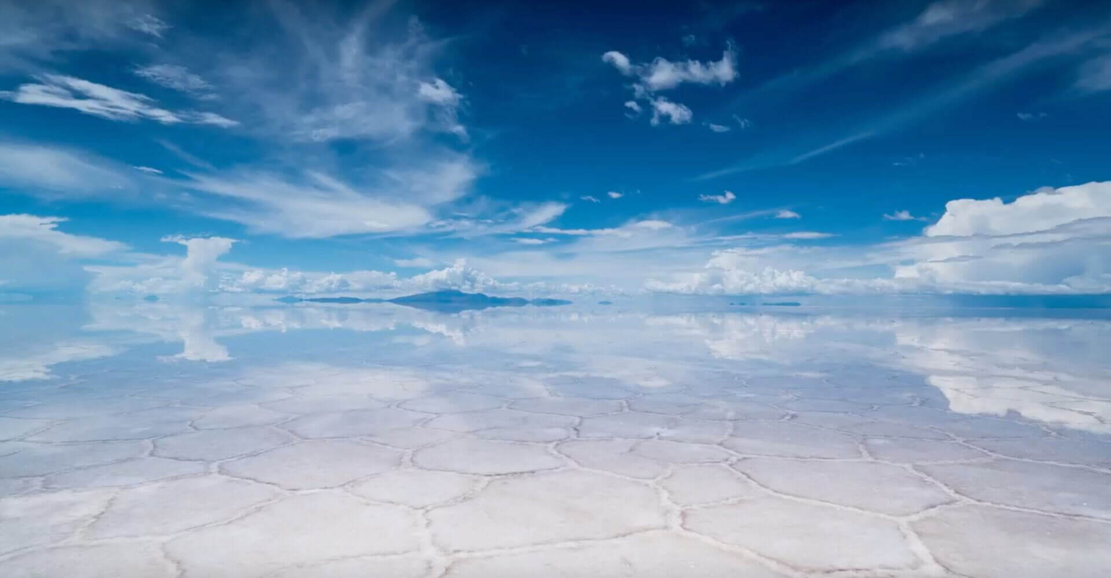
The Uyuni Salt Flats
The Uyuni Flats is a unusual name for a wonder. Many people would refer to Niagara Falls, or Angel Falls, since no one has heard of it. But this is the biggest and highest landscape in the world, more that several thousand miles above the sea level AND MILES LONG. Come with me on a journey to the Uyuni Salt Flats in Bolivia, South America.

Slide 3
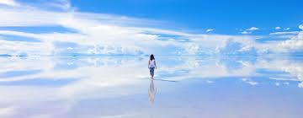
Physical Features Of The Uyuni Salt Flats
This massive salt desert stretches to 12,000 miles long.
It sits 3653 meters above sea level and that it amazing
10 billion tons of salt held
World’s largest lithium reserve
Looks like a giant mirror that you can walk on and drive on.
Stretches 120m in the water
In April-October, creates a never-ending pattern of risen polygon shapes.

Slide 4
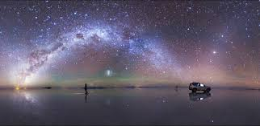
How was it created?
Dating back about 40,000 years, the Salar de Uyuni salt flat originally formed a part of the giant prehistoric lake, Lago Minchín. Covering the majority of southwest Bolivia, the ancient lake eventually dried up leaving behind Lago Popo, Lago Uru Uru and two salt deserts including our own Salar de Uyuni. Extending to great depths of up to 120m according to scientists, Salar de Uyuni present-day salt provides foundations for vehicles which travel across it during the dry season but, what makes it most remarkable is its transformation when the rain arrives in November.

Slide 5
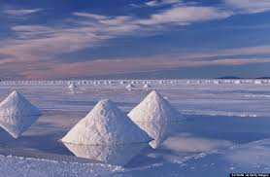
Why should The Uyuni Salt Flats Be Included In the Seven Wonders?
This massive salt lake should be included in the Seven Natural Wonders of the world because this massive sea of salt that has risen polygon shapes in a never ending chain? And it looks like a GIANT mirror AND you can WALK ON IT? I mean, come on! That is cool. It's also a part of history since it was formed from a prehistoric lake 40,000 years ago. I think that is super cool, I mean who doesn’t think walking on water is cool?

Slide 6
Back Home
Well, I hope you enjoyed your trip to the Uyuni Salt Flats. I hope you learned a few things about this gigantic mirror-like structure. The flats were formed tens of thousands of years ago. This salt desert deserves to be called one of the natural wonders of the world.
Goodbye,
Hope you enjoyed the trip!

