Slide 1
Exploring the World of Wonder!
#KINDNESS
By: Srinath Neelamagam and Gal Elkarat

Slide 2
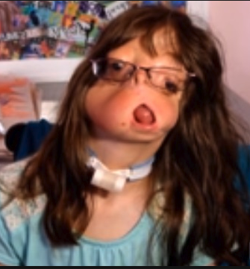
Questions and Answers
Question: After watching the video, describe how the author got the idea to write the story.
A: The author, R.J. Palacio got the idea to write the story when she met a girl who had a facial deformity at an ice cream shop. Her younger son (who was about 3 years old) started to act crazy and was crying when he saw the girl’s face and in fact, she was already thinking about how her son would react before he saw her. When her older son came, he also was shocked looking at the girl’s face. Based on her children’s actions and what she thought it would be like in that girl’s shoes, she decided to write the book, someone just like the girl, Auggie.

Slide 3
Questions and Answers
Question: After reading the article-interview with the author, write three new interesting facts you learned and tell why you found them interesting.
Answer: I have learned that 1: the book has inspired readers to write songs, poems, send cards, chapters from different points of view, and even celebrate Auggie’s birthday. Also, 2: when R.J. Palacio says that she would be more like Charlotte instead of Summer by saying “ If I'm completely honest, I would say I was probably more like Charlotte when I was that age. I probably would have been nice — I know I was never mean — but I don't think I went out of my way to be as kind as I could have been.” this made me think about would be honest about this question and say that they would not be like Summer. Most people would be more of a Charolette in all honesty. 3: I also learned that the “choose kind” quote was very important and had a great message to it. R.J. Palacio says that “You know, sometimes because especially at that age, you're in an argument with a friend and you know you're right, [but] you need reminding that ultimately the important thing is to choose to be kind, not choose to be right.” that is the message of wonder, to be kind.

Slide 4
Questions and Answers
Question: In Palacio’s response to the thank you note on her blog, she says, “My hope is that [Wonder] helps children who look like your son, too, to have a better understanding and more empathy for children like your son.” Do you think Wonder will help children be better understanding and empathetic like R.J. Palacio hopes? Why or why not.
Answer: We think that Wonder will help children be better empathetic and understanding because now that there is a book and movie, those who did not read the book can also see the movie and see what is like to be different first hand from people like Augie’s shoes.

Slide 5
Questions and Answers
Question: In the video where you learn about facial differences, why does RJ Palacio call Nathaniel Newman her “real-life Auggie”?
Answer: R.J. Palacio called Nathaniel Newman her “real life Auggie” because he was an example of a kid with a craniofacial deformity. She could base Auggie of of Nathaniel because she wanted them to be similar to each other.

Slide 6
What message does
it share?
Question: After watching the video, write the message, or lesson, it shares with the viewer.
Answer: The message of the video is that it doesn’t matter how you look on the outside, it matters what is inside. It shares that you judge someone by his/her face. You have to look through the face and reach the heart. Auggie’s mother said that we all have something on our face that represent what we have been through. However, the heart is what shows us the future.

Slide 7
Syndromes
Facial Cleft syndrome
Goldenhar/Hemifacial Microsomia
The Facial Cleft syndrome is a rare condition in which there are areas of absent bone and sometimes overlying skin, that may occur either on one or both sides of the face .
The Goldenhar/Hemifacial Microsomia syndrome Hemifacial Microsomia/Goldenhar syndrome is a condition in which the lower half of one side of the face does not grow normally.

Slide 8
Themes in Wonder
People are people regardless of their appearance. So, you should treat them like normal people. Like Mr. Tushman had explained, “Auggie can’t change the way he looks. So, maybe we can change the way we see.” Olivia also says “If they stare let them stare. You can’t blend in when you were born to stand out.”

Slide 9
Favorite quote
Gal’s favorite quote is Mr. Tushman’s quote “Auggie can’t change the way he looks. So, maybe we can change the way we see.” I think this is the best quote that support the theme of the movie, to not judge someone by how they look on the outside what matters is on the inside.
Srinath’s favorite quote is Olivia’s quote. “If they stare let them stare. You can’t blend in when you were born to stand out.” I think this is the best quote that supports the theme of the movie because it tells the audience that they should be treated the same way although they may appear different on the outside.
Notes:
9

Slide 10
Step 1
The message in the PSA example 1 is that we should help the kids that are hungry, have food to eat every day, and help them survive. We know this because in the video, kids who did not have food were holding up signs about how they need food to survive and that they don’t even know the next time that they will be fed. One kid also tell us to not ignore the signs and that we have to help.
The message in the PSA example 2 is that internet safety is very important and that we should pass it on to others that may not follow the internet safety rules well or do not know about them. We know this because in the video, a girl tries to pass on the rules of internet safety to another girl who does not know the rules.

Slide 11
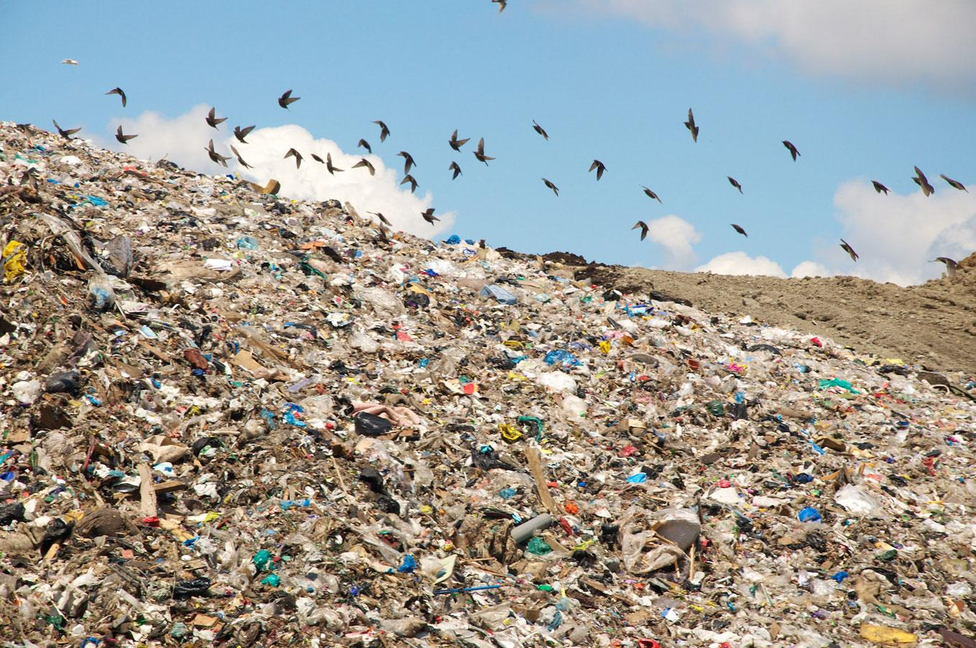
Our PSA message
The message of our PSA is to save the environment by recycling. Save the Earth from turning it into landmasses of garbage.
If you want to watch our PSA, skip to the last slide!

Slide 12
Step 11
We want the audience to behave differently by caring for the environment more and always recycle what we should. We urge them to take the following pledge: I (name) pledge allegiance to the three arrows of the recycling system, and that I will never throw garbage into the recycling bin and never throw recyclable items in the trash bin.

Slide 13
Public Service Announcement
Click here to view our PSA!
We all have to recycle each and every day!

