Slide 1
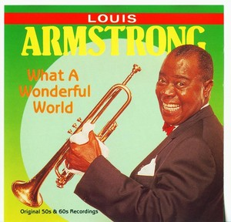
A WONDERFUL WORLD:
A LOUIS ARMSTRONG WEBQUEST FOR CLASS 5-301

Slide 2
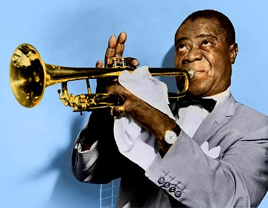
INTRODUCTION:
Louis Armstrong was the greatest of all Jazz musicians. Armstrong defined what it was to play Jazz. His amazing technical abilities, the joy and spontaneity, and amazingly quick, inventive musical mind still dominate Jazz to this day. Only Charlie Parker comes close to having as much influence on the history of Jazz as Louis Armstrong did. Like almost all early Jazz musicians, Louis was from New Orleans, from a very poor family and overcame a lot of adversity in his life to become one of the most-admired musicians ever.

Slide 3
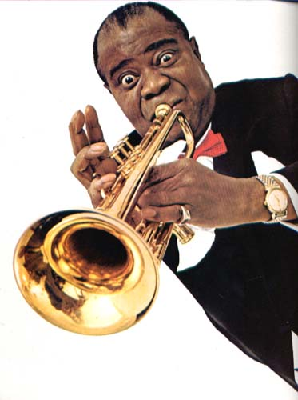
INTRO:
In this webquest, you will:
learn more about his life (including the time he spent living in Corona, Queens!)
Learn about his cultural contributions
Learn why and how his life was unusual and remarkable
Learn about his lasting legacy
Record note facts about Louis Armstrong and new vocabulary words that pertain to him and the Harlem Renaissance

Slide 4
INTRO:
WE WILL FOCUS ON THE FOLLOWING ESSENTIAL QUESTIONS:
How did Louis Armstrong affect and impact pop culture and society?
How was he impacted by the environment or society in which he lived in? (zeitgeist)
What important life lessons does he teach us about life? In other words, what is Louis’ legacy?

Slide 5
INTRO:
YOU AND YOUR PARTNER WILL THINK OF A CREATIVE PRESENTATION-PRODUCT OF YOUR FINDINGS. IT CAN BE MULTI-MEDIA, THREE DIMENSIONAL, FLAT OR ANYTHING ELSE YOU CAN THINK OF! BE CREATIVE!

Slide 6
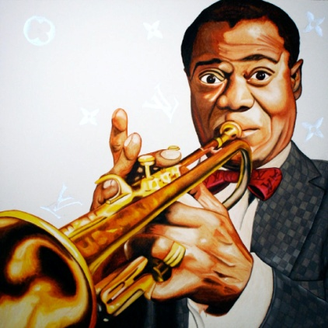
TASK:
AFTER VISITING AS MANY OF THE FOLLOWING SITES, YOU AND YOUR PARTNER WILL THOUGHTFULLY ANSWER THE FOLLOWING QUESTIONS:
How was this person's life unusual or remarkable?
How was this person's life admirable?
What personal qualities shaped this person and made him or her influential?
Which quality or trait was most beneficial?
To what extend did your person depend on assistance from a mentor? To what extent did he or she have a support network of friends and colleagues? How did this affect his or her work and personal life?

Slide 7
TASK:
What do you think it means to be a hero? Was your person a "hero"? Why? Why not? How is a hero different from a celebrity?
How was your person shaped by the environment or society in which he or she lived? Did he or she rebel against that environment? Did rebelling work? How and to what extent? (Reaction to Little Rock 9-1957)
Analyze lyrics to “Wonderful World.” What do you think the message is? How does that compare to what Armstrong has said about the song?
If you could talk to this person now, what would you ask & why?
What lessons can we learn from the life of this person?

Slide 8
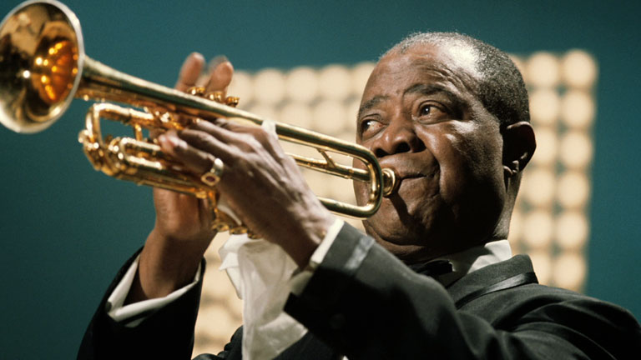
TASK:
YOU WILL ALSO INDEPENDENTLY WRITE A FIVE PARAGRAPH
ESSAY IN WHICH YOU SELECT AN IMPORTANT IDEA-THEME-
MESSAGE YOU WISH TO SHARE ABOUT LOUIS ARMSTONG
AND HIS LEGACY. STICK TO YOUR THEME-BIG IDEA AND
PROVIDE THREE EXAMPLES WITH TEXT EVIDENCE BASED
ON THE RESEARCH THAT YOU AND YOUR PARTER CONDUCTED.
SUBMIT A BIBLIOGRAPHY MLA STYLE.

Slide 9
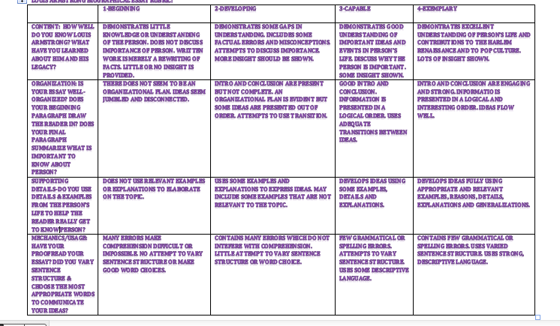
ESSAY RUBRIC:

Slide 10
PROCESS:
Visit as many of these sites as possible to help assist in answering the questions:
http://www.biography.com/people/louis-armstrong-9188912/videos/louis-armstrong-mini-biography-11162179733
http://www.biography.com/people/louis-armstrong-9188912/videos/louis-armstrong-what-a-wonderful-world-1550403769
http://www.pbs.org/jazz/biography/artist_id_armstrong_louis.htm
http://pbskids.org/chuck/index.html#/jazz

Slide 11
PROCESS:
http://historyoftheharlemrenaissance.weebly.com/musicians.html
http://www.redhotjazz.com/louie.htmlhttp://kidsmusiccorner.co.uk/composers/jazz/louis-armstrong/
http://www.makingmusicfun.net/htm/f_mmf_music_library/hey-kids-meet-louis-armstrong.htmhttp://www.dailymotion.com/video/x1ysp1_louis-armstrong-what-a-wonderful-wo_musichttp://www.azlyrics.com/lyrics/louisarmstrong/whatawonderfulworld.html
https://www.youtube.com/watch?v=kmfeKUNDDYs
https://www.youtube.com/watch?v=wyLjbMBpGDA

Slide 12
EVALUATION:
Organization and Content :
1-Little to no comprehensive organization.
1-Inappropriate and/or unclear content. Responses not geared at all towards questions. No insight shown
2-Moderate organization.
2-Appropriate but minimal content. Responses could be more geared towards questions. More insight could be shown.
3-Well organized.
-Appropriate content. Responses mostly geared towards questions. Some insight shown.
4-Very well organized.
4-Adaptable working content and easily understood. Responses entirely geared towards questions. A lot of insight shown

Slide 13
EVALUATION:
4
Research:
1-Little to no research.
1-N0 to few sources cited. Research copied ver batim (plagiarized)
2-Adequate research.
2-Small amount of sources cited. Some research copies—some paraphrased.
3-Thorough research
3-Adequate number of sources cited-most research paraphrased and put in own words
4-Exceptional research.
-Many effective sources cited. All info paraphrased and put in own words

Slide 14
EVALUATION:
PRESENTATION:
1-Not aesthetically pleasing.
1-Difficult to comprehend and/or follow.
2-Slightly appealing.
2-Not easily followed.
3-Aesthetically pleasing.
3-Easily comprehended and followed.
4-Outstanding visual properties.
4-Comprehensive without question.

Slide 15
EVALUATION:
Effectiveness
1-Not effective.
2-Moderately effective.
2-Participants gain some knowledge.
3-Effective.
3-Participants gain acceptable amount of knowledge.
4-Very effective.
4-Participants gain a wealth of knowledge.

