Slide 1
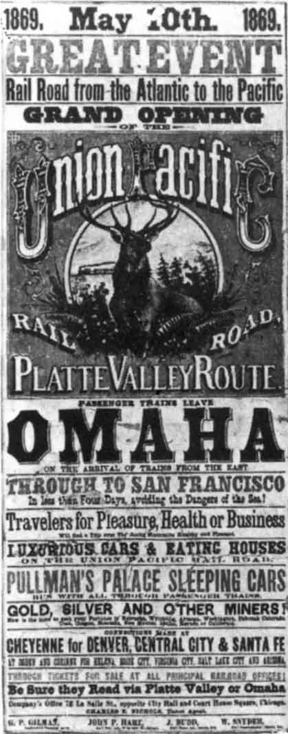
RAILROAD POSTER
You live in the late 1800’s
and are designing a poster to
advertise the NEW railroad
that is coming to town.
Use all the “eye-catching”
details you can. Offer cheap
travel, sell cheap land where
the railroad travels or give
travelers places to find gold
or silver where the railroad
runs…it’s all up to you!

Slide 2
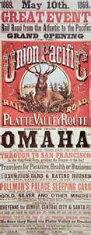
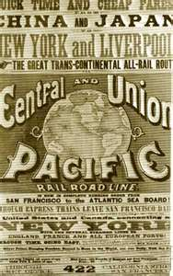
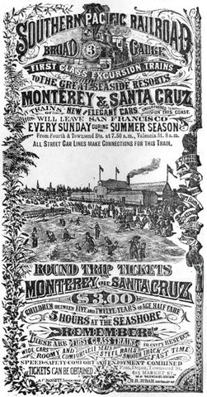

Slide 3
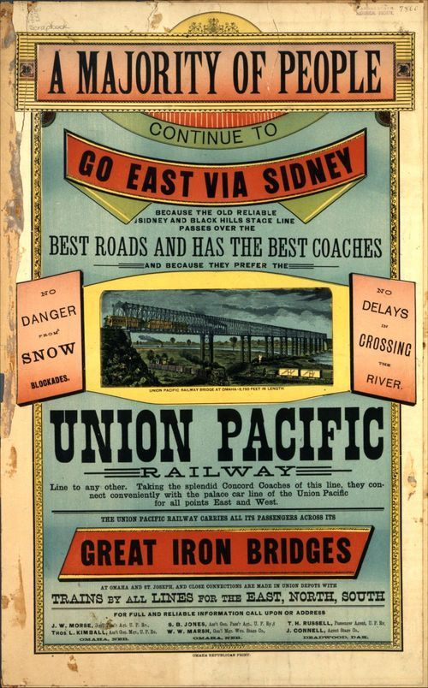
Poster Details
Your poster must include
the following:
Location (state/city?)
What railroad? (Union
or Southern Pacific)
Date (should be
between 1865-1870
Tell about the sights
and experiences
(nice train? scenic route?)

